Slide 1

Database Management System (CS232) BS(SE,CySec) gg
Week 05
Said Nabi
said.nabi@giki.edu.pk
Faculty of Computer Science and engineering
Gik Institute Topi, Swabi

Slide 2
Relationships
Mandatory Vs Optional Cardinality
Example of ERD
Different Types of Keys

Slide 3
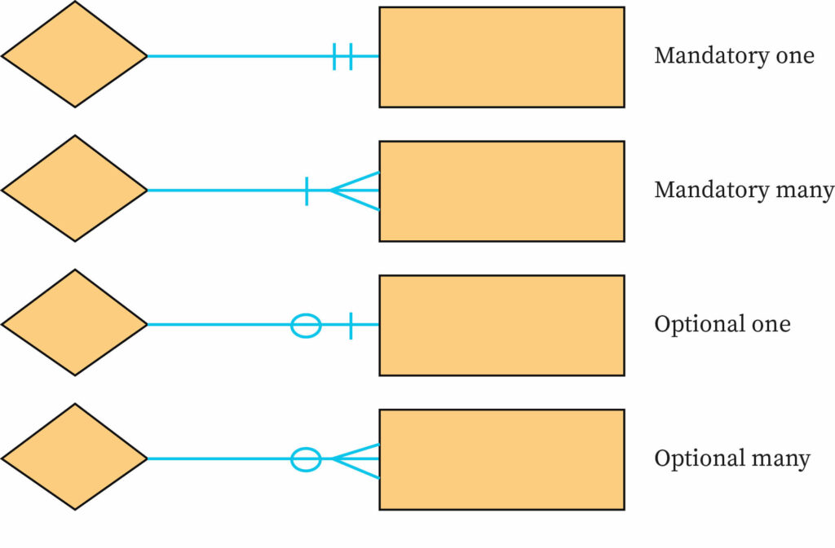
Mandatory vs. Optional Cardinality Crow’s foot Notation
Specifies whether an instance must exist or can be absent in the relationship
Has
CNIC
Has
Employee
Has
Garage
Register
Courses

Slide 4
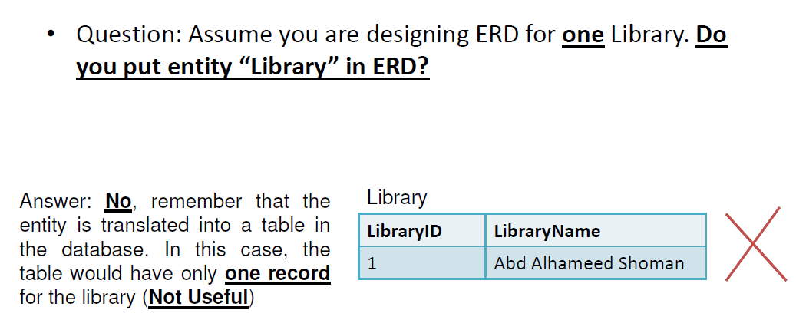
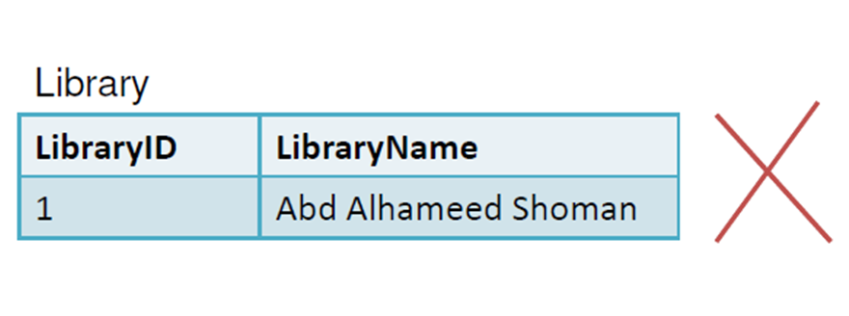
Important Note
Fast Library

Slide 5
Example#1 Requirements of the Company
The company is organized into DEPARTMENTs.
Each department has a name, number and an employee who manages the department.
We keep track of the start date of the department manager.
Each department controls a number of PROJECTs.
Each project has a name, number and is located at a single location.
We store each EMPLOYEE’s social security number, address, salary, gender, and birth-date.
Each employee works for one department but may work on several projects.
We keep track of the number of hours per week that an employee currently works on each project.
We keep track of each employee’s direct supervisor.
Each employee may have a number of DEPENDENTs.
For each dependent, we keep track of their name, gender, birthdate, and relationship to employee.

Slide 6
Steps to Create an ER Diagram
Entity Identification
Relationship Identification
Cardinality Identification
Attribute Identification
Draw ER diagram

Slide 7
Identification of Entities
The company is organized into DEPARTMENTs.
Each department has a name, number and an employee who manages the department.
We keep track of the start date of the department manager.
Each department controls a number of PROJECTs.
Each project has a name, number and is located at a single location.
We store each EMPLOYEE’s social security number, address, salary, gender, and birth-date.
Each employee works for one department but may work on several projects.
We keep track of the number of hours per week that an employee currently works on each project.
We keep track of each employee’s direct supervisor.
Each employee may have a number of DEPENDENTs.
For each dependent, we keep track of their name, gender, birthdate, and relationship to employee.

Slide 8
Initial Conceptual design for the Company Database
From the requirements of the company DB we can identify the following entities:
DEPARTMENT
PROJECT
EMPLOYEE
DEPENDENT
In the next few slides, we will show how the above four entities together with their attributes are represented using ER diagram.

Slide 9
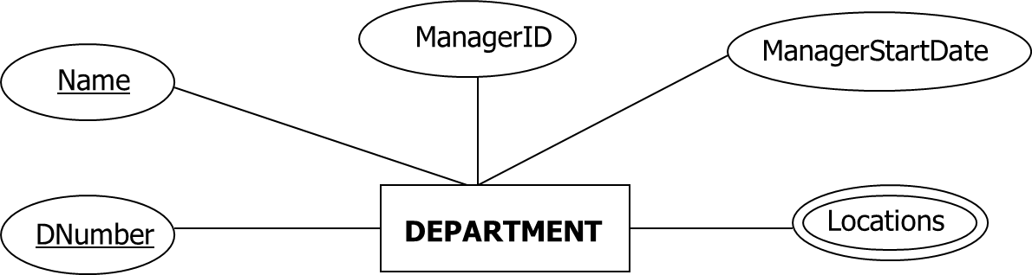
DEPARTMENT Entity Representation
An entity type DEPARTMENT has attributes:
Name (key identifier)
DNumber (key identifier)
Locations
ManagerID and
ManagerStartDate.

Slide 10
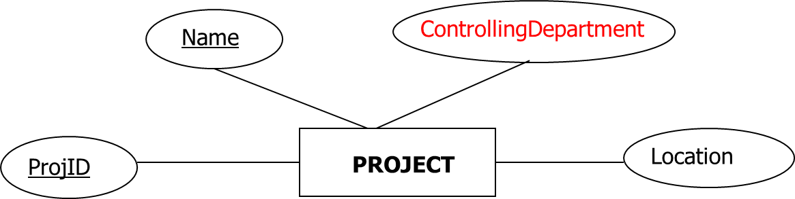
PROJECT Entity Representation
An entity type PROJECT has attributes:
Name (key identifier)
ProjID (key identifier)
Location
ControllingDepartment
Notes:
ControllingDepartment means Project entity will be linked with Department with some relationship. This column will act as FK in Implementation
Project StartDate and EndDate, Total Budget are also required columns

Slide 11
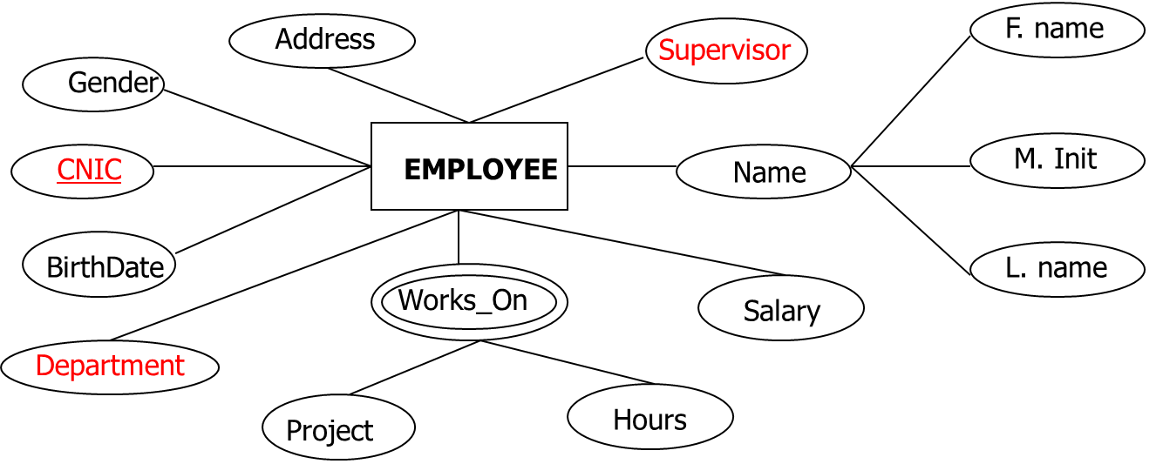
EMPLOYEE Entity Representation
An entity type EMPLOYEE with attributes:
Name, CNIC, Address, Salary, BirthDate, Department, Supervisor, and WorksOn.
WorksOn is multi-valued composite attribute (project, Hours).
CNIC is the key attribute. Both name and address can be composite attributes.

Slide 12
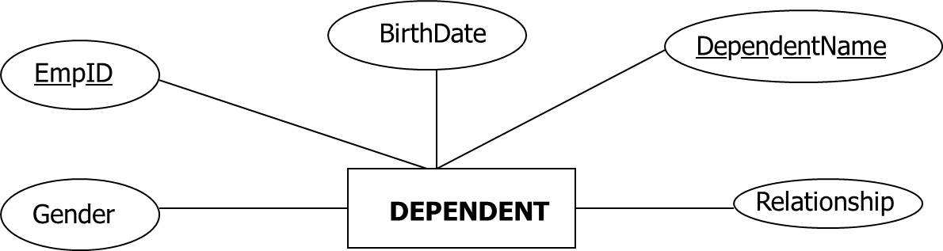
DEPENDENT Entity Representation
An entity type DEPENDENT (family members) has attributes:
EmpID
DependentName
Gender
BirthDate
Relationship
Notes:
When linked with Employee, EmpID will act as FK

Slide 13
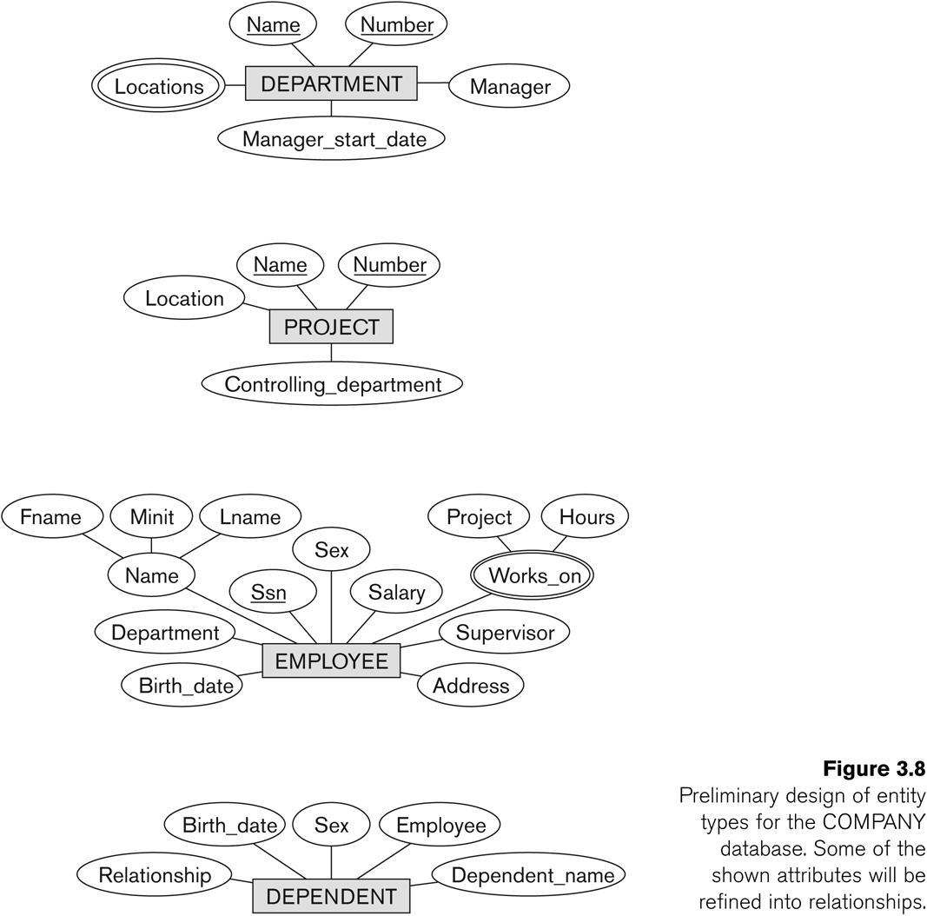

Slide 14
Department & Employee
Consider Employees are working in departments:
Department
Employee
Manager/ Boss??
Employees belong to Departments
Some employees are managers of department
Employee may work in more than one dept
Some are managers of other employees
Entities
Relationships
Notes:
Manager is a job title, it is not an Entity rather it is managed inside Employee

Slide 15
Basic Examples
MANAGES
EMPLOYEE
DEPARTMENT
BELONGS TO
Employee
DEPARTMENT
MANAGES
EMPLOYEE
DEPARTMENT
BELONGS TO

Slide 16
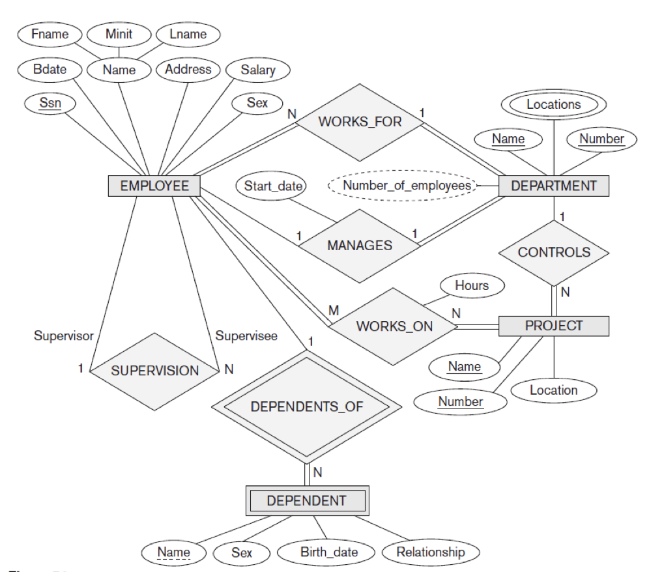
ER diagram for the company database

Slide 17
Example #2: Requirements of LMS
The university is organized into DEPARTMENTS, each with a unique name, code, and a PROFESSOR who heads the department, along with the joining date of the department head. Each department offers multiple COURSES, each identified by a unique course code, title, and assigned semester. The system stores each STUDENT’s roll number, name, address, date of birth, contact number, and email. Students enroll in one department but may register for multiple courses each semester, with grades recorded for each course. The system also manages information about FACULTY MEMBERS, including their employee ID, name, qualification, contact details, and date of joining. Each course is taught by one faculty member, though a faculty member may teach multiple courses. Additionally, each student may have multiple FEE TRANSACTIONS, with records maintained for transaction dates, amounts paid, and outstanding balances. This structure captures the essential entities and relationships needed for developing an ERD for a University LMS.

Slide 18
Relational Database Models
Revision (Core Concepts)
As we know it was combination of following:
Tables
(Relations)
(Entities)
Rows
(Records)
(Tuples)
(Entity Instance)
Columns
(Characteristics )
(Attributes)
Degree
(Entity to Entity)
Cardinality
(Record to Record)
Domain
(Possible values of attribute)

Slide 19
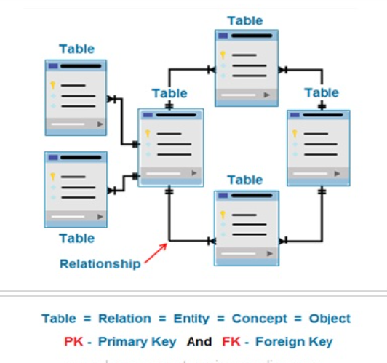
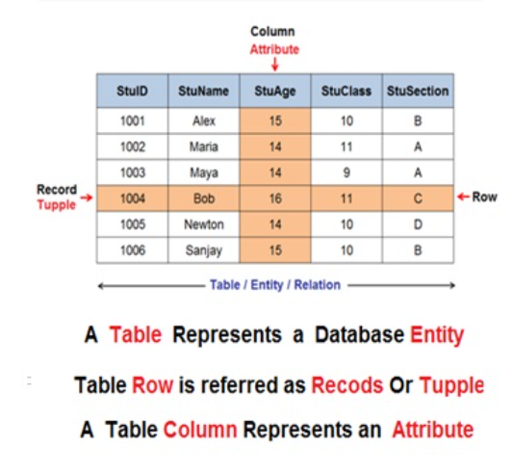
Relational Database Models
Revision (Core Concepts)
The structure was some thing like this:

Slide 20
Relational Database Models
THIS TIME GO MORE DEEP INTO IT
Concept of KEYS in Relational Databases
1
A key in a table/relation might be an attribute or set of attributes.
It helps in uniquely identifying a tuple/row/record in a table/relation.
2
These are defined to sequence and access/store the data quickly.
3
Keys also help in establishing relationship between different records.
4

Slide 21
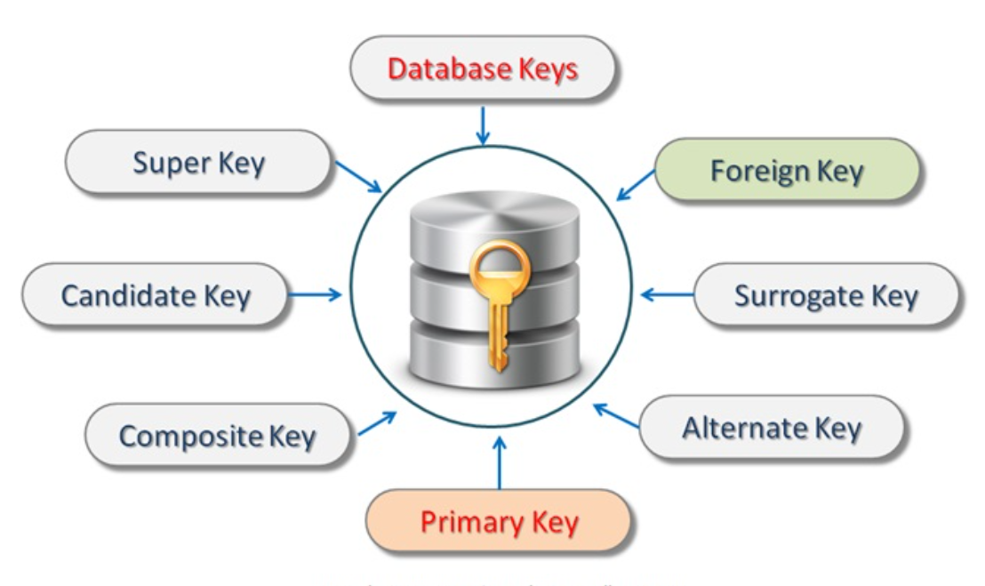
Relational Database Models
Types of Keys in Relational Database Models

Slide 22
Relational Database Models
StudentID | Name | Address | Department
101 | Ahmed Ali | Karachi, Pakistan | Computer Science
102 | Ayesha Khan | Lahore, Pakistan | Business Admin
103 | Bilal Hussain | Islamabad, Pakistan | Electrical Eng.
104 | Fatima Noor | Rawalpindi, Pakistan | Mechanical Eng.
105 | Uzair Khan | Peshawar, Pakistan | Computer Science

Slide 23
Relational Database Models
Composite key:
Set of attributes are used to uniquely identify a record.
Course Offerings
Program_Code | Course_code | Section | Credit_Hours
CS | 101 | J | 3
HM | 101 | A | 3
MT | 112 | B | 3
CS | 112 | F | 2
HM | 112 | E | 3

Slide 24
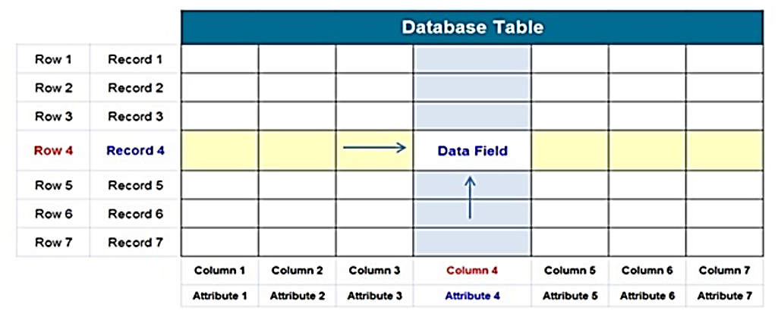
Relational Database Models
Why Do we need keys in Database
1
To reduce duplication/redundancy
To enhance consistency.
2
To give/assign a reference value to each record
3

Slide 25
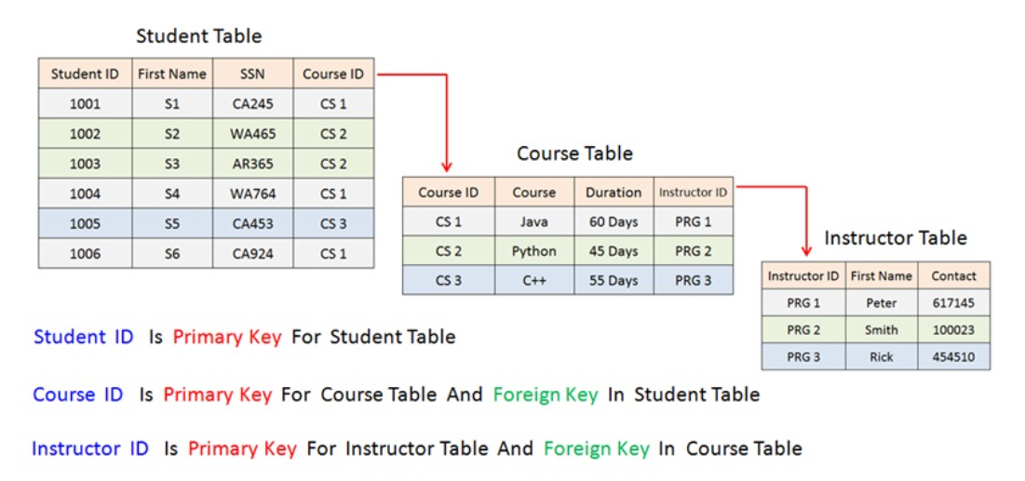
Relational Database Models
“In the table each column have unique name but the table rows does not have unique name. Therefore we need database key so that each row in table can be uniquely identified”.
Why Do we need keys in Database

Slide 26
Relational Database Models
Why Do we need keys in Database (Example)
A table key can be a unique single attribute such as student ID”, employee ID, SSN (Social Security Number) that has an unique value for each row in a table.
If the table doesn’t contains a unique attribute that can be used as database key then the combination of two or more keys can be used to define the database key for that table.
What if a table don’t have any unique attribute in Database
How do we apply a key in Database
In database, system designers/ database designers first check all the entities, then they analyze all attributes and find the one with unique values to use it as a key attribute.

Slide 27
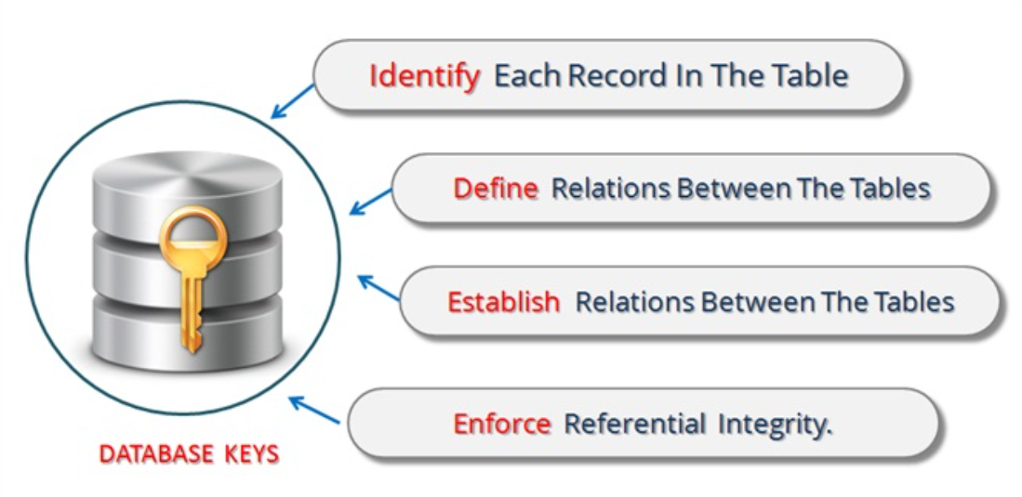
Relational Database Models
In database design phase the database designer decompose the larger database tables into the smaller tables that contains data about one entity only, then they analyze all attributes and find the one with unique values to use it as a key attribute.
How do we apply a key in Database

Slide 28
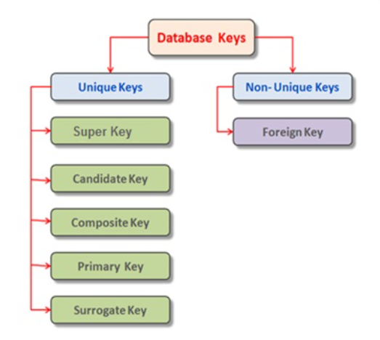
Relational Database Models
Types of Database Keys

Slide 29
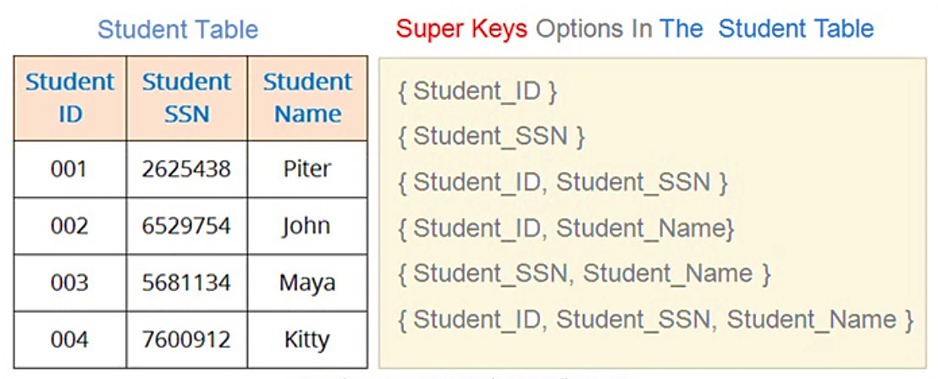
Relational Database Models
Super key is defined as either a single attribute or group of attributes that can be used to uniquely identify each row in a table
The super key is the most general form of the unique key. The table can have many super keys. A set of super key is usually super-set of other keys
It is the most generic type of a key
SUPER KEY

Slide 30
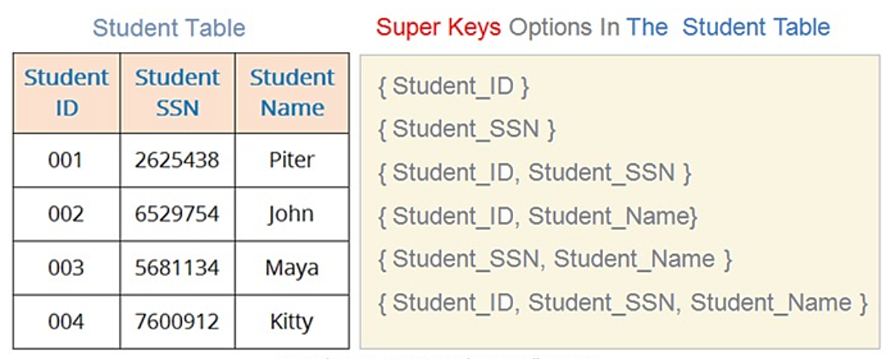
Relational Database Models
The following table have six number of super-keys
The attributes Student_ID and Student_SSN will always have unique values for each instance of student table, therefor both of these attributes qualify for the super key.
The Student_Name attribute individually do not qualify for super key.
But if use Student_Name along with any of super key attribute then it will also become a super key.
SUPER KEY

Slide 31
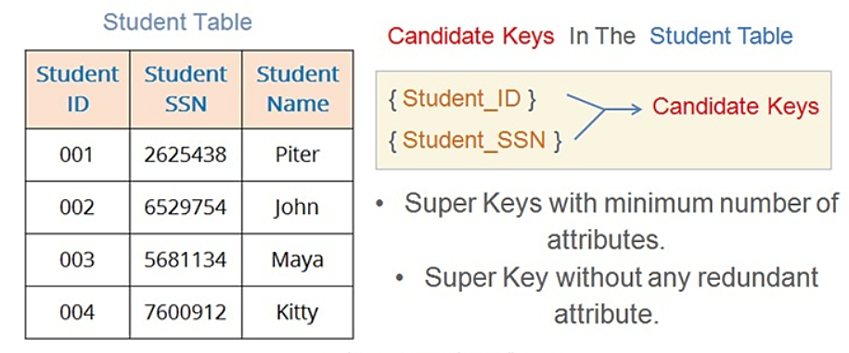
Relational Database Models
CANDIDATE KEY
Candidate key is defined as the super key with minimum number of attributes. In other words it is a super key with no redundant attributes.
Main purpose of candidate key is to offer multiple options to database designers so that suitable primary key can be selected.
Each candidate key have full ability to function as primary key but one is selected by database designer.
Each candidate key is super key but every super key may not be a candidate key.
Notes:
unnecessary for uniqueness.

Slide 32
Relational Database Models
Types of Database Keys

Slide 33
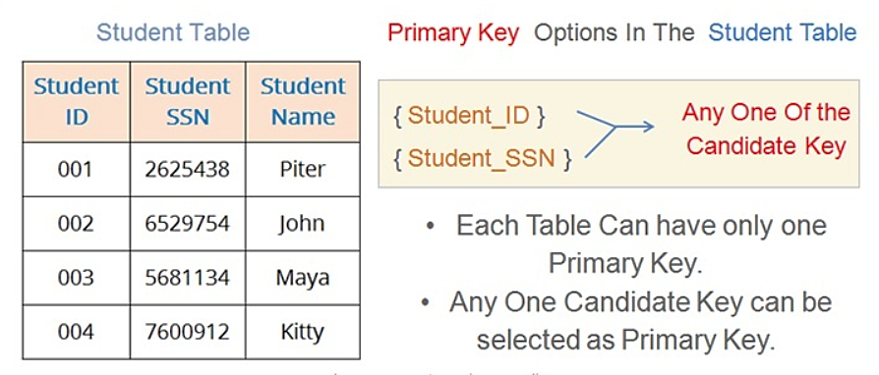
Relational Database Models
Primary key is the most important feature of database that is selected by database Administrator to uniquely identify all records.
Each table can have only one primary key.
If there are multiple candidate key then one primary key is selected out of them.
PRIMARY KEY

Slide 34
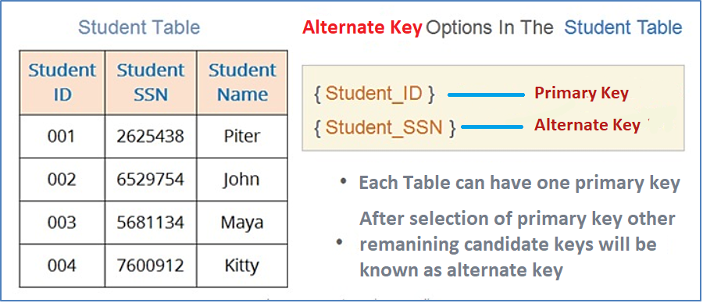
Relational Database Models
In previous slide we have studied that primary key is selected out of the candidate keys
For Example: As we have two candidate keys in following table Student_ID and Student_SSN
If we have selected Student_ID as primary key in following table
Then Student_SSN will become Alternate key for the following table.
ALTERNATE KEY

Slide 35
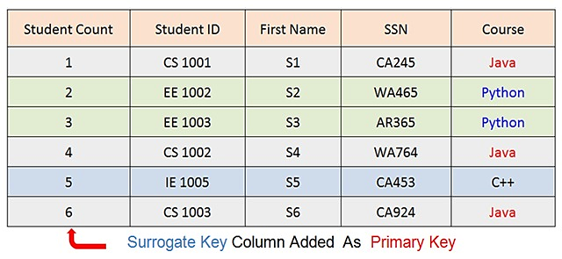
Relational Database Models
To understand Surrogate Key first we need to understand the natural key
Natural keys are basically those attributes who don’t have redundant value and they actually belong to the nature and type of entity. In other words their inclusion helps in identifying the type of entity.
Now if a table don’t have any natural attribute with unique values. Then we add a new attribute to uniquely identify all attributes as shown in following table.
That new attribute will be called as Surrogate Key which will act like the primary key.
SURROGATE KEY

Slide 36

Any Questions??

